Slide 1
The Chairs: A Theatrical Journey into Absurdity

Slide 2
Introduction
Background
Plot Summary
Themes
Symbolism
Characters
Style
Reception
Impact
Conclusion

Slide 3

Introduction
Students, welcome to our presentation on the renowned playwright Eugene Ionesco and his masterpiece 'The Chairs'. Today, we will take you on a journey through the fascinating world of this absurdist play that has captivated audiences for decades.
Ionesco was a master of the theater of the absurd, a genre that explored the meaninglessness of human existence in a chaotic and irrational world. In 'The Chairs', he creates a surreal and dreamlike atmosphere that challenges our perceptions of reality and forces us to confront some of life's biggest questions. So sit back, relax, and get ready to be transported to a world of wonder and mystery.

Slide 4

Background
Eugene Ionesco was a Romanian-French playwright who is considered one of the foremost figures of the Theatre of the Absurd. He was born in Romania in 1909 and moved to France in 1942, where he spent the rest of his life. Ionesco's work is known for its exploration of the human condition in a world that is often chaotic and meaningless.
Ionesco wrote 'The Chairs' in 1952, during a period of great social and political upheaval in Europe. The play is set in a world that is on the brink of collapse, with characters who are struggling to find meaning in their lives. It is a powerful commentary on the isolation and futility of modern existence, and it has been praised for its innovative use of language and its ability to capture the essence of the human experience.

Slide 5
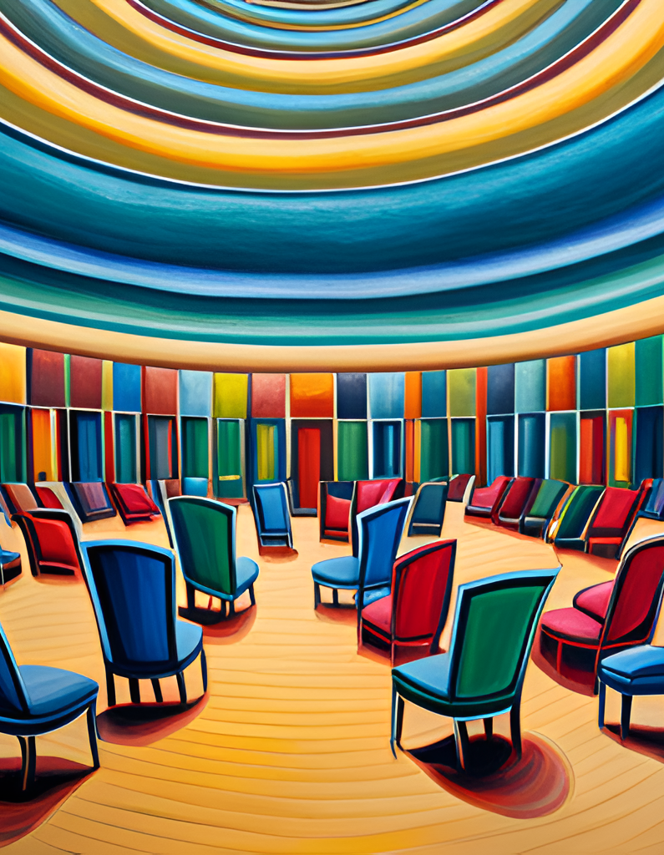
Plot Summary
In 'The Chairs', an elderly couple prepares for the arrival of a large audience, whom they believe will hear a message of great importance. The Old Man has spent his life writing a speech that he believes will change the world, but he is now too old and infirm to deliver it himself. He has invited a series of imaginary guests to listen to him, represented by rows of empty chairs that fill the stage.
As the play progresses, the couple reminisces about their past and their disappointments, while the Old Man struggles to find someone to deliver his message. Eventually, a deaf-mute orator arrives to speak on their behalf, but the message turns out to be meaningless gibberish. The play ends with the couple disappearing into the void, leaving behind only the empty chairs as a symbol of their unfulfilled dreams and aspirations.

Slide 6
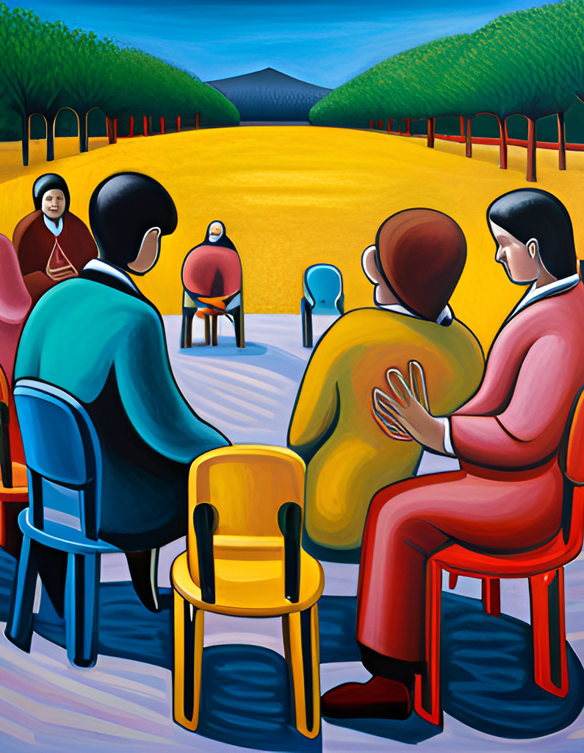
Themes
One of the major themes of 'The Chairs' is the nature of reality. The play explores the idea that reality is subjective and can be shaped by our perceptions and beliefs. This theme is exemplified by the Old Man's obsession with creating an audience for his message, even though the audience is ultimately revealed to be imaginary. Through this character, Ionesco suggests that the human need for validation and connection can lead us to create illusions that we mistake for reality.
Another important theme of 'The Chairs' is the human condition. The play portrays the loneliness and isolation that can result from our inability to communicate effectively with others. The Old Man and Old Woman are unable to express their love for each other or connect with the outside world, which leads to a sense of despair and futility. This theme is particularly relevant in today's society, where communication technology can sometimes create a false sense of connection while actually exacerbating feelings of isolation and disconnection.

Slide 7
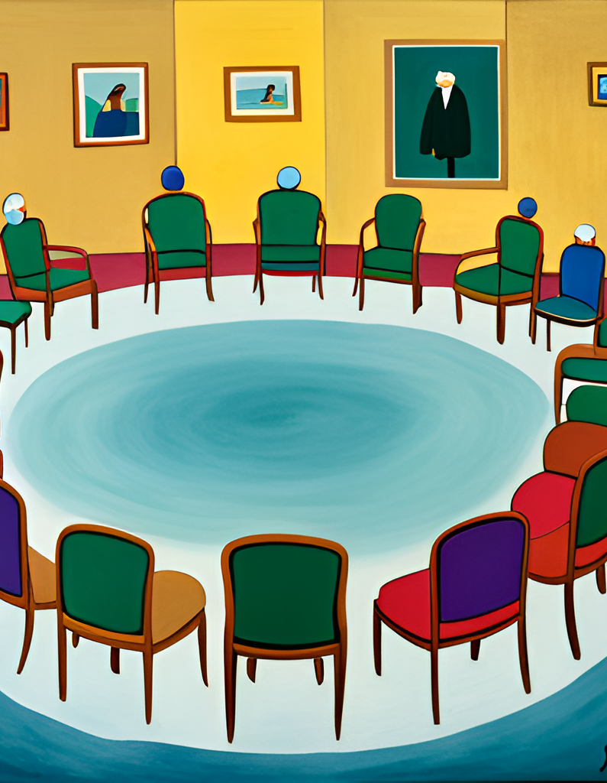
Symbolism
In 'The Chairs', Eugene Ionesco uses symbolism to convey complex themes and ideas. One of the most prominent symbols in the play is the empty chairs, which represent the absence of meaning and the futility of communication. The chairs also symbolize the emptiness of life and the inevitability of death. The old man's speech, on the other hand, symbolizes the human desire for connection and understanding, despite the inherent limitations of language.
By using these symbols, Ionesco creates a sense of ambiguity and uncertainty that reflects the absurdity of the human condition. The play challenges the audience to question their own perceptions of reality and the meaning of existence, while also highlighting the importance of human connection and communication.

Slide 8
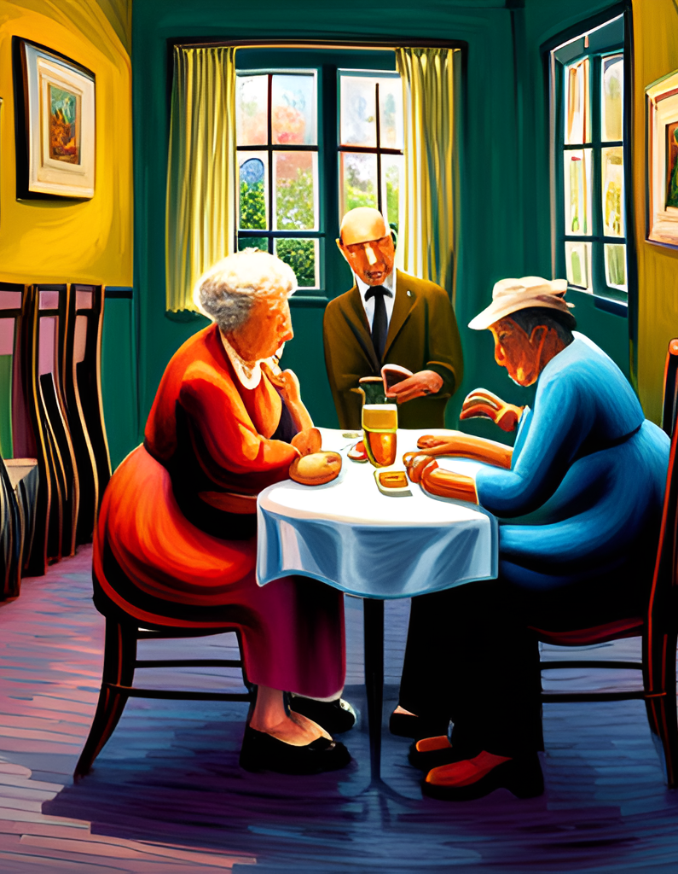
Characters
In 'The Chairs', Eugene Ionesco creates two characters who are both tragic and comic. The Old Man and the Old Woman are an elderly couple who have spent their lives together, yet they are unable to communicate with each other. The Old Man is deaf and mute, while the Old Woman is able to speak but cannot seem to get through to her husband. Despite this, they continue to live together in a kind of symbiotic relationship, relying on each other for companionship and support.
The Old Man is a complex character who is both pitiable and admirable. He is trapped in his own world, unable to communicate with those around him, yet he remains optimistic and hopeful. He is a dreamer, and his dreams are a source of comfort and joy for him. The Old Woman, on the other hand, is a more practical character who is frustrated by her inability to connect with her husband. She is often exasperated by his behavior, yet she remains loyal to him and cares for him deeply. Together, these two characters create a poignant and memorable portrait of the human condition.

Slide 9
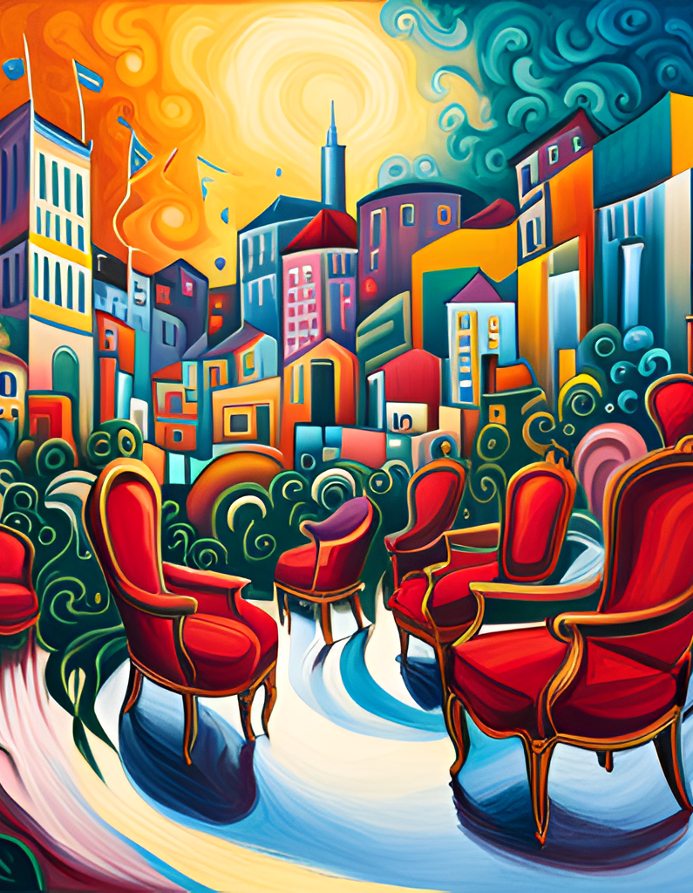
Style
Eugene Ionesco's 'The Chairs' is a masterful example of absurdist theater, characterized by its unconventional structure and use of language. The play features a series of disjointed scenes that are often surreal and dreamlike, blurring the line between reality and fantasy. This fragmented structure mirrors the disorienting experience of the characters, who struggle to make sense of their own existence in a world that seems devoid of meaning.
One of the most striking aspects of 'The Chairs' is its use of language. Ionesco employs a range of linguistic devices, including repetition, nonsense words, and non-sequiturs, to create a sense of dislocation and confusion. The dialogue is often stilted and awkward, highlighting the characters' inability to communicate effectively with one another. At the same time, however, the play is also filled with moments of beauty and poetry, as the characters grapple with the fundamental questions of human existence.

Slide 10
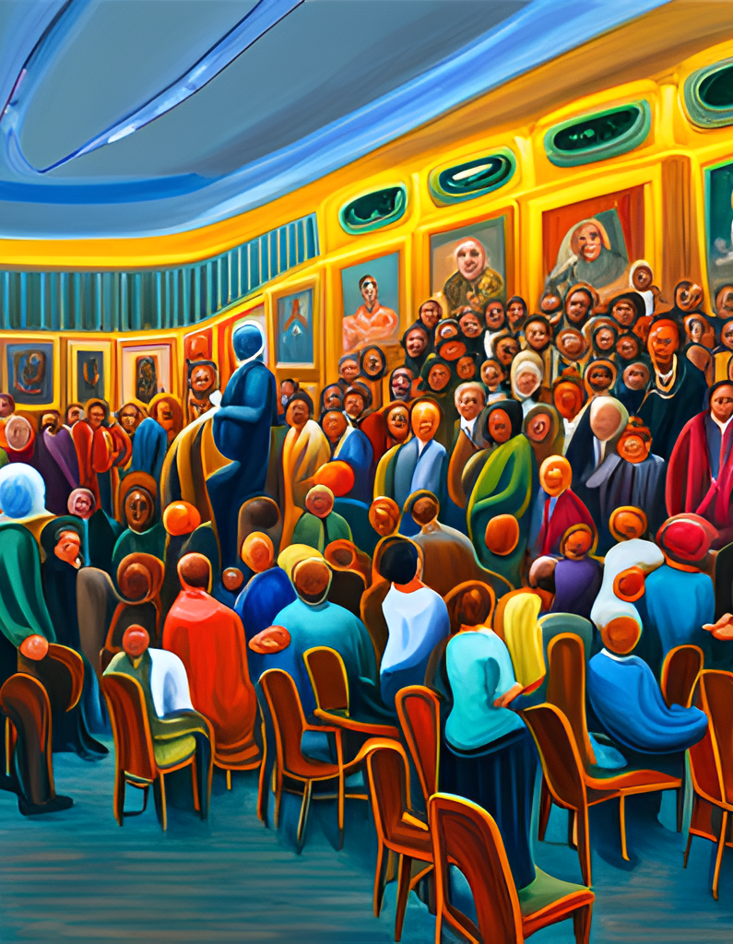
Reception
When 'The Chairs' was first performed in 1952, it was met with mixed reviews. Some critics praised Eugene Ionesco's use of absurdity to comment on the human condition, while others found the play confusing and meaningless. However, over time, 'The Chairs' has come to be recognized as a landmark work of modern theater, influencing generations of playwrights and directors.
In modern times, 'The Chairs' continues to be widely performed and studied. Its themes of isolation, communication, and the search for meaning resonate with audiences around the world. While some may still find the play challenging or difficult to understand, its place in the canon of modern theater is secure.

Slide 11
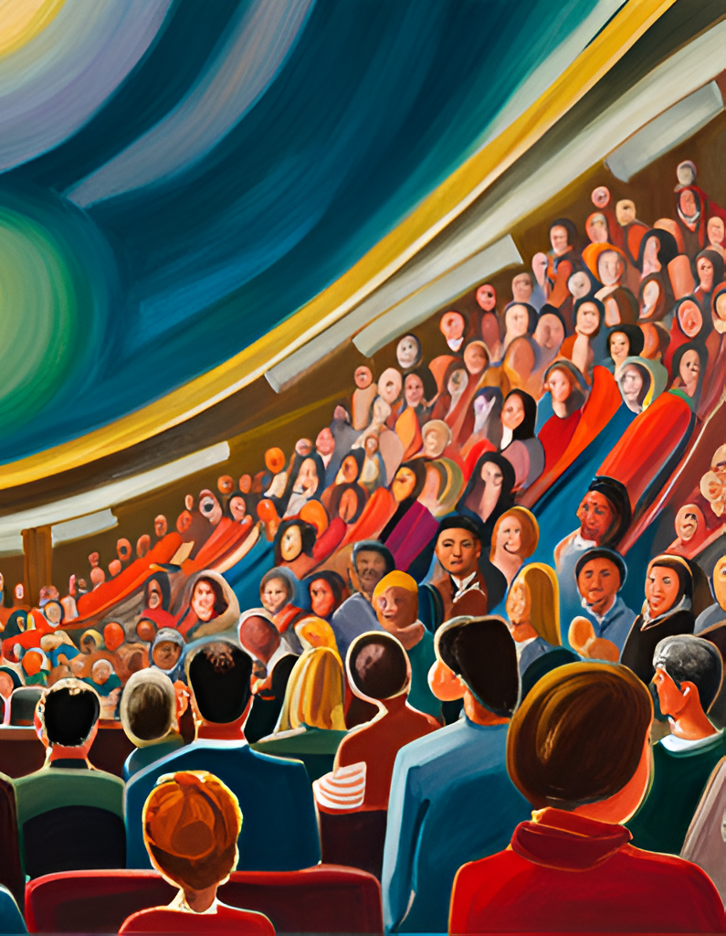
Impact
Eugene Ionesco's 'The Chairs' has had a profound impact on modern theater and literature. The play's innovative use of language, structure, and symbolism has inspired countless playwrights and authors, and its exploration of existential themes continues to resonate with audiences today.
In addition to its artistic influence, 'The Chairs' also played a significant role in the development of the Theater of the Absurd, a movement that sought to challenge traditional theatrical conventions and explore the absurdity of human existence. The play's impact can be seen in the works of other prominent absurdist playwrights such as Samuel Beckett and Harold Pinter.

Slide 12
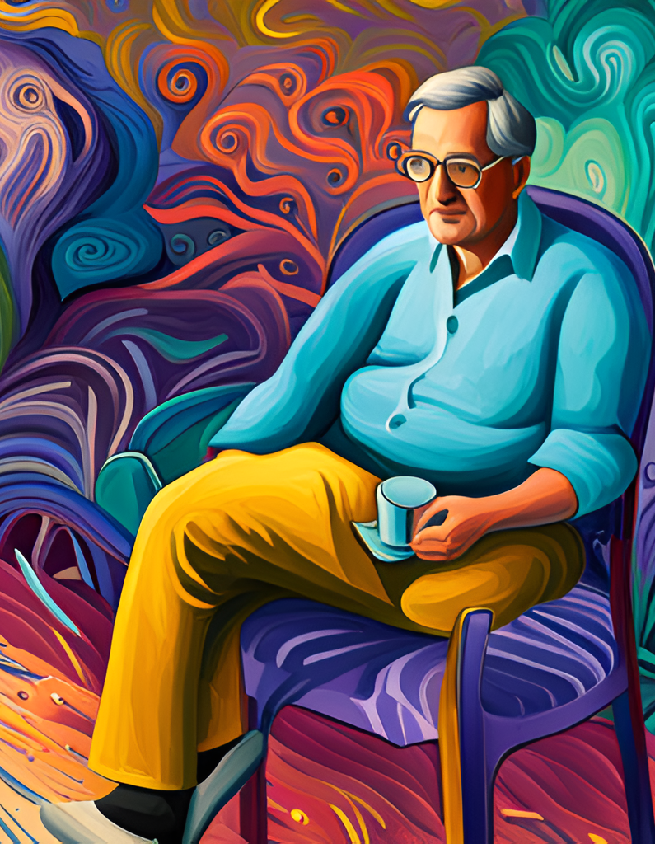
Conclusion
In conclusion, 'The Chairs' is a thought-provoking play that explores the nature of reality and the human condition. Through its use of symbolism and complex characters, it challenges the audience to question their own perceptions of the world around them.
Furthermore, Eugene Ionesco's artistry in language and structure make 'The Chairs' a masterpiece of modern theater. Its impact on literature and theater cannot be overstated, as it continues to inspire and influence artists today.

